Slide 1
Simulation of 1992-93 NHL Season
Chase Lane

Slide 2
Season Overview
Pens hot after 2 Back to Back Stanley cups
Finished with an excellent record of 56-21-7
Mario Lemieux diagnosed with Hodgkins Lymphoma
On pace to challenge Wayne Gretzky’s famous records, but had season abruptly ended
Despite missing about 28% of the regular season, he finished with the most points in the league
Won Art Ross and Hart Trophies
Pens favored for “three-peat”
Highest scoring regular season in NHL History
7,311 goals scored over 1,008 games for an average of 7.25 goals a game
Only 68 shutouts recorded during regular season

Slide 3
Season Format
Regular Season Format
Each team played a total of 84 games
Total of 1,008 games in a regular season
2 Conferences
Prince of Wales (East) and Clarence Campbell (West)
4 Divisions – 6 teams each
Adams, Patrick, Norris, Smythe
Playoff Format
Top 4 teams per division make it
8 teams per conference
No wildcard teams/games – No bye rounds
Play games respective to division 1v4, 2v3
Teams are seeded solely from division, no conference standings

Slide 4
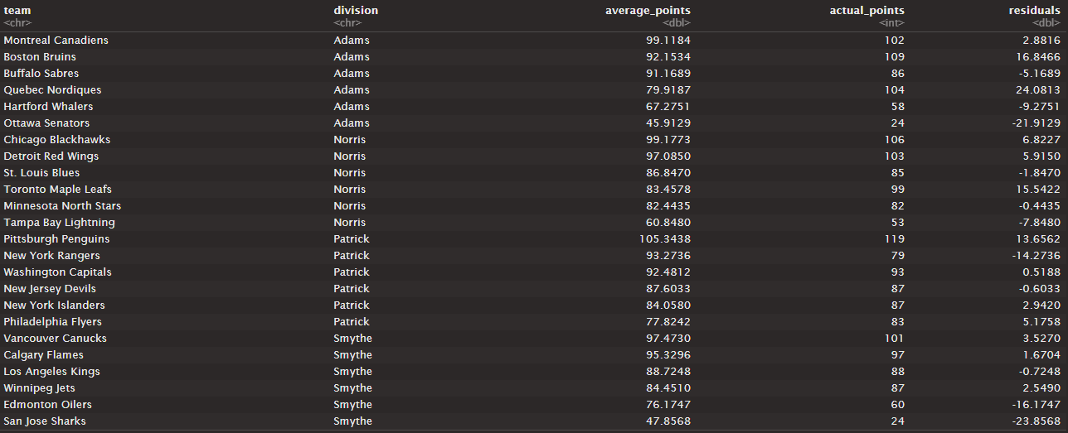
Simulated Regular Season Results

Slide 5
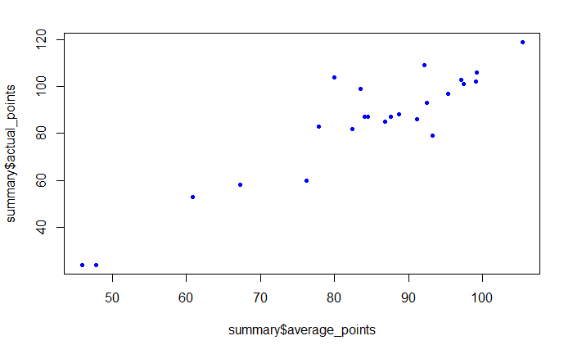
Comparison of Simulated and Actual Regular Seasons
Simulated points vs Actual points
Cor = .927
Strong correlation
Two bottom left teams with low sim and actual points
Senators and Sharks
Both expansion teams
Top right team
Penguins
Highest sim points with 105
Highest actual points with 119

Slide 6
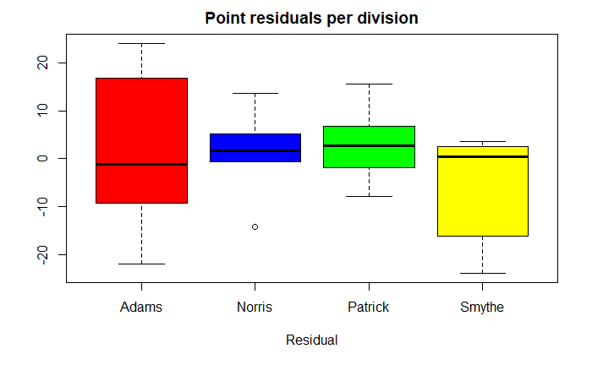
Comparison of Simulated and Actual Regular Seasons
Point Residuals per Game
Adams division had the highest volatility with the lowest mean
Norris had small range with an outlier
Outlier – Tampa Bay Lightning
First year in league
Simulation struggles with expansion teams
Patrick most normal distribution out of the four
Smythe had a higher mean than Adams but more teams fell below expectations

Slide 7
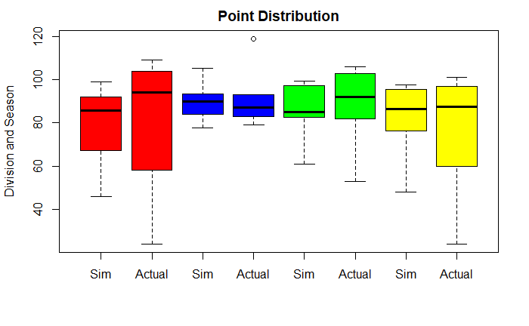
Comparison of Simulated and Actual Regular Seasons
Point Distributions
The simulation did a decent job of predicting the season
There was a lot of underachieving teams during the actual season shown by the tails of the box plots
The means are very close for the Sim vs Actual
Outlier in the Patrick Division for the actual season
Penguins – very large positive residual of 13.65

Slide 8
Regular Season Results
Pens, Blackhawks, Canadiens, Canucks, Red Wings, Flames, Capitals, Bruins, Sabres, Kings all fell within expectations
In simulation, each of these teams made playoffs >90% of the time
Pens, Blackhawks, Canucks won their respective divisions the most
Canadiens won their division the most in simulation
Actually, finished third
The Bruins, who actually won it, only won in the simulation about 20% of the time

Slide 9
Regular Season Results
New York Rangers
Did not make playoffs at all in real life – finished bottom place in Patrick Division
Simulation had them making playoffs 87% of the time and winning the division 10% of the time
Quebec Nordiques
Finished second in the Adams division
Simulation had them making playoffs 88% of the time and winning the division ~1%
Since 16 teams made the playoffs and 3 teams were brand new, there isn’t much surprise in which teams actually made the playoffs
The biggest upset had to be the Rangers
Second place went to the Nordiques with them turning around their previously awful season

Slide 10
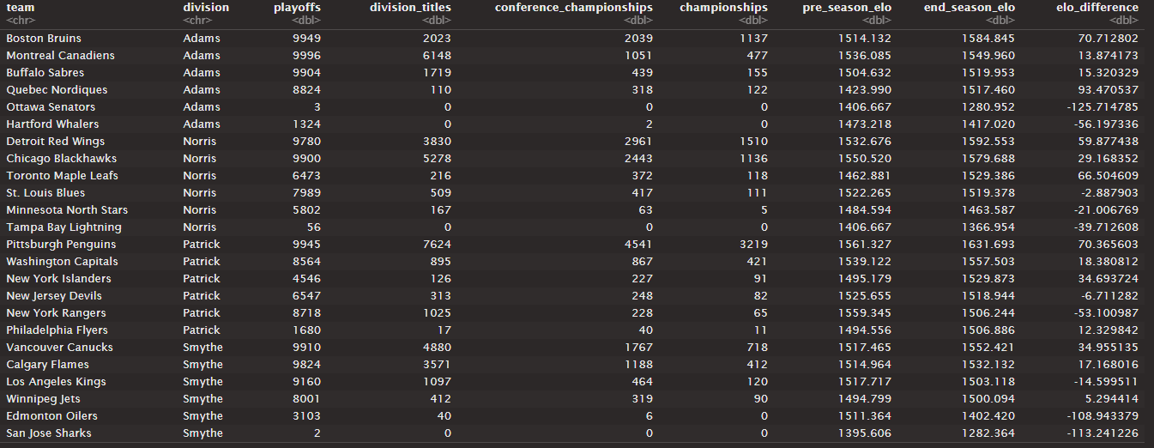
Simulated Playoff Results

Slide 11
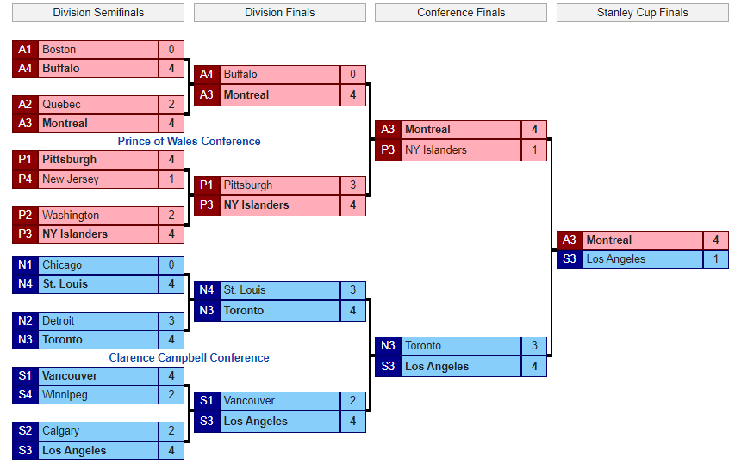
Actual Playoff Bracket

Slide 12
Comparison of Simulated and Actual Playoffs
Numerous upsets in actual playoffs
Third ranked team in each division made it to their respective conference finals
Notable upsets include:
Canadiens beating Boston
Islanders beating Pens
Blackhawks, winner of Norris division, swept in first round
Detroit beat by Leafs first round
Canadiens 11 win streak going to win the Stanley Cup
Pens – largest cup favorite – eliminated in second round
Blackhawks, Bruins, Canucks, Flames
All favored to make a deep Stanley cup run
Eliminated either first or second round

Slide 13
Comparison of Simulated and Actual Playoffs
Simulation predictions for actual conference champions
Canadiens - 10.5%
Kings – 4.6%
Low percentages considering 3rd ranked team in each division
Pens odds of winning Stanley cup ~32%
Canadiens – 4.7%
Simulation favored Pens and Red Wings to make the championship game
Both teams had the highest Elos
Red Wings eliminated first round, Pens second

Slide 14
ANALYZING INDIVIDUAL TEAMS
Close to expectations – Washington Capitals
Underachiever – San Jose Sharks
Overachiever – Quebec Nordiques
Caps - Nearly identical simulation and actual points
Simulation had them making playoffs most of the time with not a very deep run predicted. Eliminated first round
Sharks – Performed well under expectations
Had an actual 11 win season
Interestingly, there were 2 seasons where the sharks made the playoffs despite having the worst record
Nordiques – Performed well above expectations
Had about 24 more points than simulation expected
Made playoffs most of the time in simulation, but again eliminated in first round

Slide 15
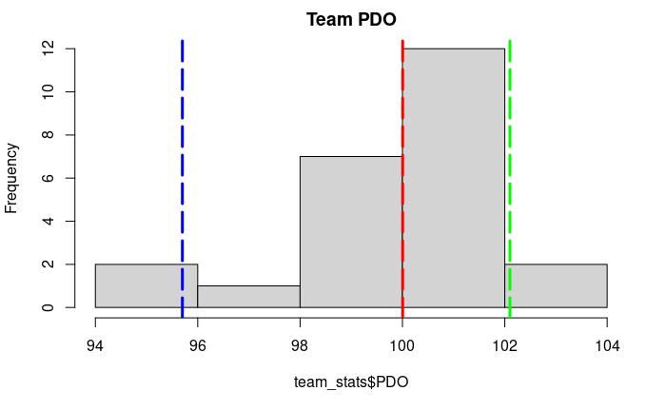
Relevant Statistics
Team PDO, measuring luck of a team
League Average PDO = 100, confirms statistic is valid
Capitals – PDO = 100
Team right on average confirming our statement
Sharks – PDO = 95.7
Second lowest in league, encountered extremely bad luck
Detrimentally affected their season
Nordiques – PDO = 102.1
Second highest in league, encountered extremely
good luck
Helped contribute to their overachieving season
Histogram of PDO Legend
Red = Average(100)
Blue = Sharks(95.7)
Green = Nordiques(102.1)

Slide 16
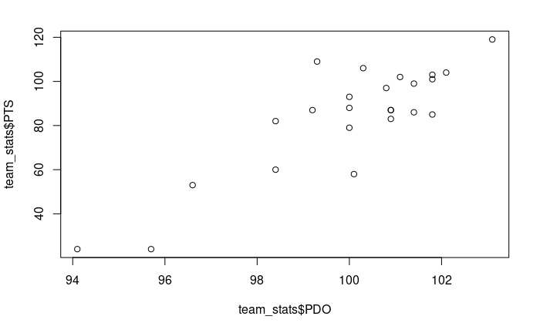
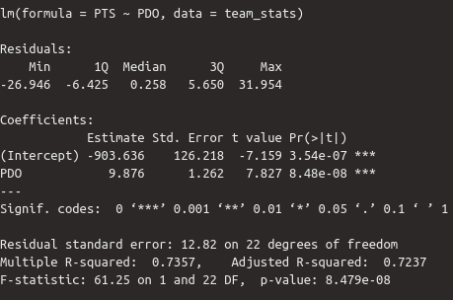
Relevant Statistics
PDO vs Actual Points
How much does luck impact winning?
Answer: A lot!!
Correlation between PDO and points ~ .858
Teams in the bottom left with extremely bad luck ex. Senators and Sharks had the lowest wins and points in the league
The Pens, in the top right, had the highest puck luck and gained the highest amount of points
Running a regression on PDO predicting PTS
PDO significant

Slide 17
CONCLUSION
By far, one of the most interesting seasons in NHL history
The shootout nature of games resulted in variable PDO values
The quantity of upsets in actual playoffs shattered simulation
Canadiens who won the cup had a 4.7% chance
Favorites eliminated left and right despite having a substantial ELO difference in opponent
The poor expansion teams suffered tremendously – far more than the simulation could ever predict
Would be interesting to take a further look at player statistics this season due to the high nature of scoring
So many players broke the 100-point barrier that it wasn’t even that impressive

